Slide 1
Programming Fundamentals
Lecture 2

Slide 2
Objectives
To review the basic syntax of a C++ program
To know about data hierarchy
To differentiate between an editor and integrated development environment (IDE)
To know about the rules of variable naming
To know about Declaration, Initialization and Definition of a Variable
To learn the correct use of operators

Slide 3
Data Hierarchy
As viewed from Computer to User
Bits→ Characters→ Fields→ Records→ Files

Slide 4
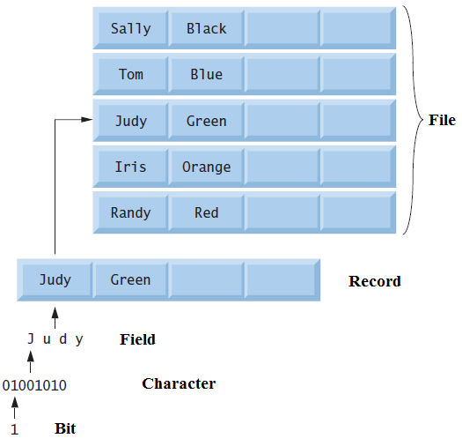
Data Hierarchy

Slide 5
Data Hierarchy
Bit
The smallest data item in a computer
Either 0 or 1
Character
Digits, letters and special symbols are known as characters
The computer’s character set is the set of all the characters used to write programs and represent data items
C++ uses the ASCII character set
Field
A field is a group of characters or bytes that conveys meaning

Slide 6
Data Hierarchy
Record
Several related fields can be used to compose a record (implemented as a class in most of the languages)
For example a payroll system may have following fields
Employee identification number (a whole number)
Name (a combination of characters)
Address (a combination of characters)
Hourly pay rate (a number with a decimal point)
Year-to-date earnings (a number with a decimal point)
Amount of taxes withheld (a number with a decimal point)

Slide 7
Data Hierarchy
File
A file is a group of related records
More generally, a file contains arbitrary data in arbitrary formats
A file is viewed simply as a sequence of bytes
Any organization of the bytes in a file, such as organizing the data into records, is a view created by the application programmer

Slide 8
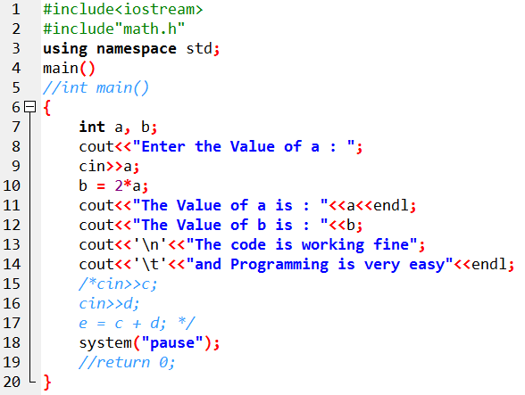
A Simple Program in C++

Slide 9
Editor and IDE
Editor
Editor is only capable of editing the text you write
For compiling, debugging or execution you need extra utilities
Notpad, wordpad
Integrated Development Environment (IDE)
It is not just a tool where you write the code ,but you can also compile, debug and execute the code
Microsoft visual studio
Dev C++

Slide 10
Header File
Header files contain definitions of functions and variables which is imported or used into any C++ program by using the pre-processor #include statement
Header file have an extension ".h" which contains C++ function declaration
Each header file contains information (or declarations) for a particular group of functions

Slide 11
Header File
One example of a header file is “iostream”
The header file named “iostream” contains the definitions of basic input and output functions like cin and cout
Similarly the header file named “math” contains the definitions of functions related to mathematics

Slide 12
Types of Header Files
System Header Files
These header files comes with compiler and contains the definitions of functions previously defined
User Header Files
These are defined by users, and contains the definitions of functions defined by user

Slide 13
Why we Need Header Files
When we want to use any function in our C++ program then first we need to import their definition from C++ library
For importing their declaration and definition we need to include header file in program
Header file are included at the top of any C++ program

Slide 14

How to Use a Header File
The header files can be included by using one of the following syntax
The use of angle brackets <> informs the compiler to search the compiler’s included directory for the specified file
The use of the double quotes "" around the filename inform the compiler to search in the current directory for the specified file

Slide 15
Commonly used C++ Commands
main( )
{
--------
}
main() function is the entry point of any C++ program
It is the point at which execution of program is started
When a C++ program is executed, the execution control goes directly to the main() function
You can use main as void main() or int main()

Slide 16
Commonly used C++ Commands
#include
Tells the compiler that I want to use specific header file
cin
cin is used for get or read value form keyboard
cout
cout is used for print message on screen
cout<<endl; and cout<<‘\n’;
Terminates the line, and start the message from new line

Slide 17
Commonly used C++ Commands
cout<<‘\t’;
Equivalent to a horizontal tab break
system(“pause”);
It runs the pause command (as though from a command line) which waits until the user presses any key
return 0;
A standard way to state that the main has successfully executed if it returns zero
Only used when we use “int main”
No need to use return 0 with “void main”

Slide 18

Commonly used C++ Commands
using namespace std;
namespace std helps to use cout command more easily
Without namespace std
With namespace std

Slide 19
Commonly used C++ Commands
// and /* */
// is used to add comments in front of a statement
If you want to a section of code as a comment then enclose the code between /* */
Stream Insertion Operator “<<“ and “>>”
Are used to input or display streams/messages
<< is used to display message
>> is used to take input from keyboard

Slide 20
Variable Naming
A variable name is called an “identifier” and is only valid if
It is not a Keyword of C++
Is a series of letters, numbers and Underscores (_)
Does not start with a Number
An identifier is case sensitive which means that A1 and a1 are two different identifiers

Slide 21
Some Logical Questions
Why we prefer ASCII codes for C++ instead of Unicode?
What is the advantage of adding a header file by using double quotes? And when we prefer this method?
Is it possible that you used system(“pause”) command in your code, but it is still not pausing? If yes, then what is the reason?
Write at least one alternative command for system(“pause”)
Where we can declare a variable in a C++ program? Is there any restriction about the position of declaration?
According to variable naming rules, the variable name can start with an underscore (_). But it is not recommended, why?

Slide 22
Declaration, Initialization and Definition of a Variable
int a;
int b = 10;
int c;
c = 8;
When we declare a variable only a block of memory is decided for that variable
When we define or initialize a variable, then memory is allocated

Slide 23
The Use of Operators
While using the operators we write the variable towards the left side of operator and its definition goes towards right side of operator
int a = 10, b = 20;
a = b;
The above statement means that value of b is assigned to a

